Slide 1
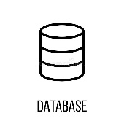







Architecture Design
Consumers worklfow/tables
Ingest
Clean
Transform
Load (Destination)
(CI/CD) DAB pipeline

Slide 2
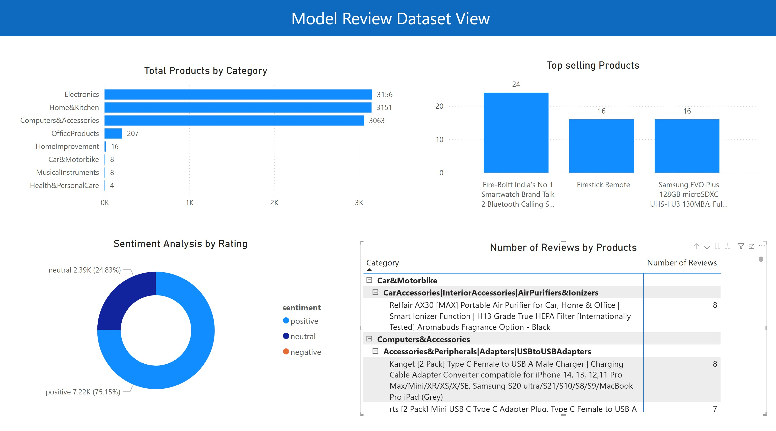

Slide 3
Orchestrator
files
File Arrival Signal Workflow
(runs every
2 mins)
watermark
triggers
publish signals
(File Arrived)
signals
Evaluator
queue
Evaluator
executed
publish signals
(workflow completion)
publish file (trigger file)
file arrival trigger
target
volume
training worflows…
train_dataset_trigger
consumer workflows…
consumer_trigger

